Slide 1



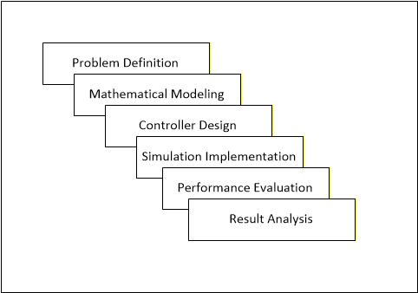
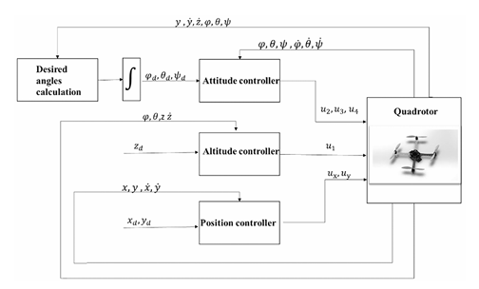
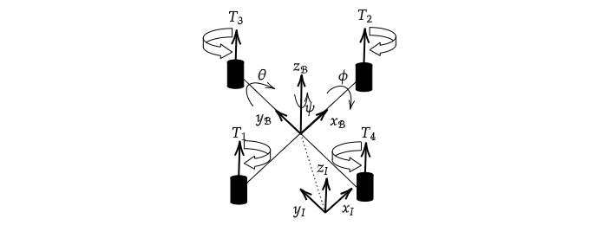
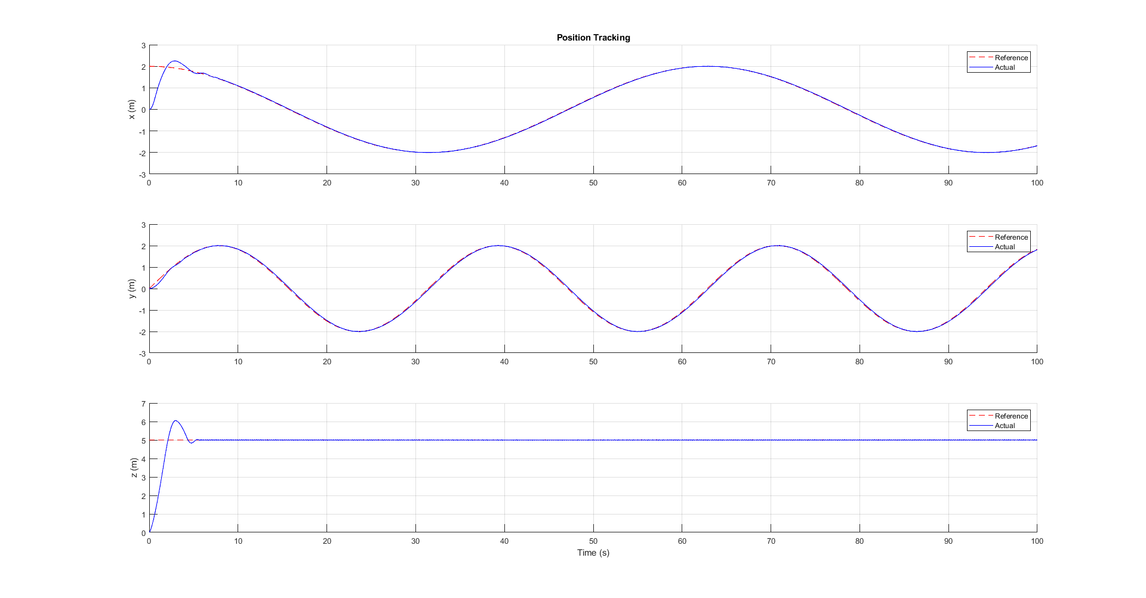
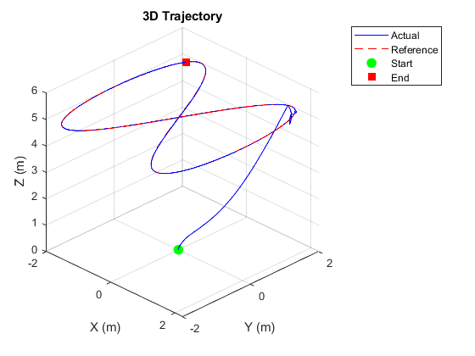
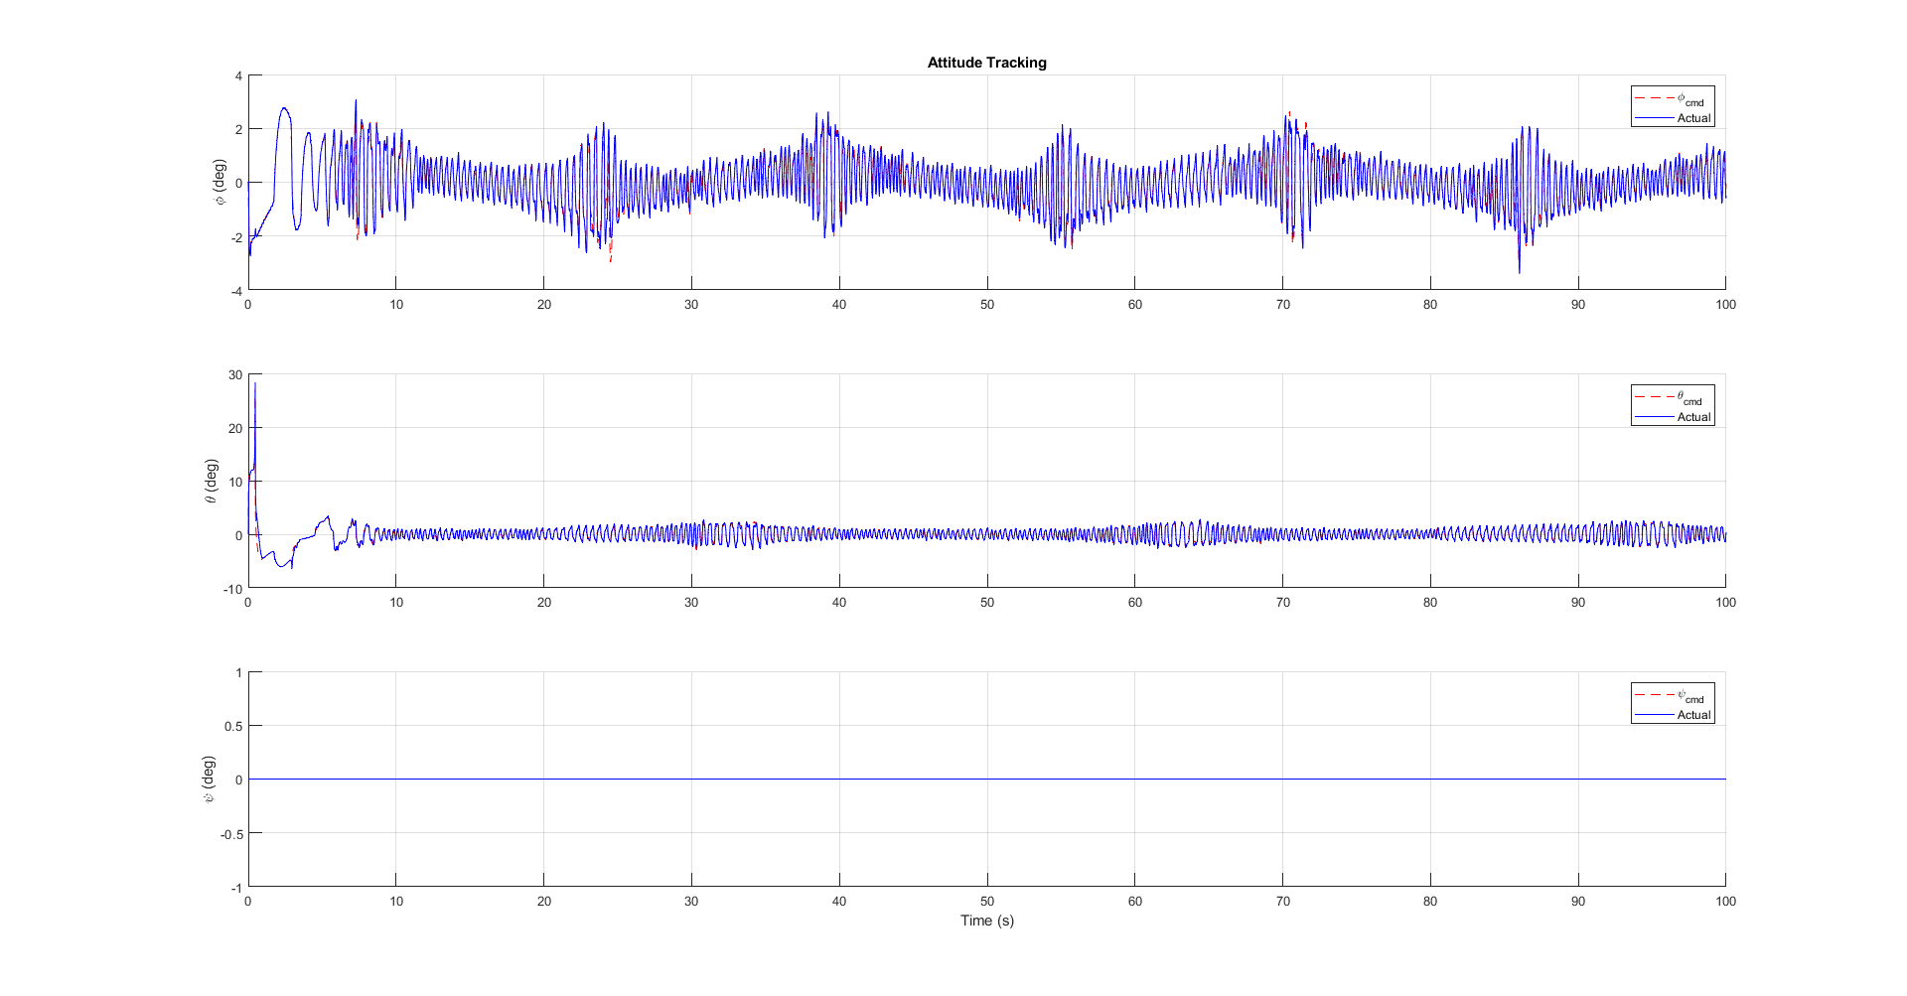
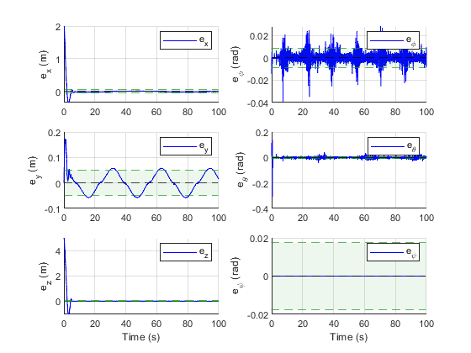
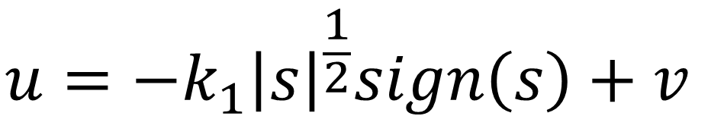
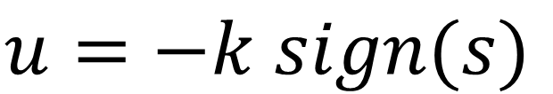
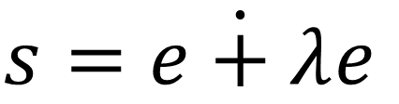
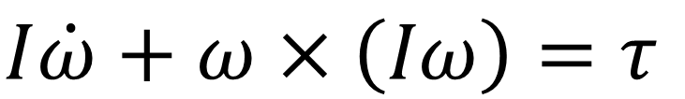
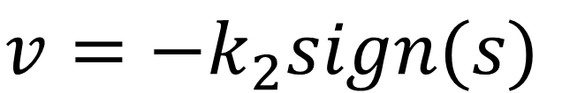
Robust Control Systems for Quadrotors
Name: Yash Dadheech Roll No: 22BCP309
Name of Supervisor: Dr. Kiran Kumari (IISc) & Dr. Rajendra Choudhary
Department of Computer Science & Engineering, SOT,PDEU
Put SDG Goal Logo as per your work
Brief Motivation
Objective
Quadrotors exhibit highly nonlinear, coupled dynamics making precise control inherently challenging.
Many conventional control strategies struggle to achieve accurate and stable trajectory tracking under real-world disturbances and uncertainties.
There is a need for advanced control system design to improve performance, stability, and responsiveness.
Addressing this challenge is essential for enabling reliable deployment of quadrotors in applications such as surveillance, mapping, and aerial robotics.
To design a control system for quadrotors that ensures stable flight under nonlinear dynamics.
To develop control strategies for accurate trajectory tracking.
To implement the designed controller in a simulation environment.
To analyze the performance of the controller under disturbances and uncertainties.
To evaluate tracking accuracy, stability, and response characteristics.
Methodology
Fig.: Workflow
Fig.: Control System Design Block
Fig.: Quadrotor configuration
Translational and Rotational Dynamics
Super Twisting Sliding Mode Controller
$$m\ddot{p}=R\left(φ, θ, ψ\right){\left[0 0 T\right]}^{T} −{\left[0 0 mg\right]}^{T}$$
$$s=\dot{e+λ}e$$
$$u=−k_{1}{\left|s\right|}^{\frac{1}{2}}sign\left(s\right)+v$$
$$I\dot{ω}+ω×\left(Iω\right)=τ$$
$$u=−k sign(s)$$
$$v=−k_{2}sign(s)$$
Expected Results
Fig.: Attitude Tracking
Fig.: Error Plots
Fig.: Position Tracking
Fig.:3D Trajectory
Outcomes
References
Understand nonlinear dynamics and control challenges associated with quadrotor systems.
Apply control strategies (SMC and ST -SMC) for trajectory tracking and stabilization.
Implement quadrotor models and controllers in simulation using MATLAB.
Evaluate the effectiveness of different control approaches through simulation results.
Kumar, S., Yesmin, A., Tripathy, T., Sinha, A., & Guha, A. (2025, December). Disturbance Analysis with Super-Twisting Sliding Mode Control for UAVs. In 2025 Eleventh Indian Control Conference (ICC) (pp. 660-665). IEEE.
Yesmin, A., & Sinha, A. (2025). Sliding Mode Controller for Quadcopter UAVs: A Comprehensive Survey. Drones, 9(9), 625. https://doi.org/10.3390/drones9090625.
Yesmin, A., Kumari, K., Borkar, A. V., Sinha, A., & Arya, H. (2022). Software-In-The-Loop validation of super twisting based sliding mode control for quadcopters. IFAC-PapersOnLine, 55(22), 123-128.
Olguin-Roque, J., Salazar, S., González-Hernandez, I., & Lozano, R. (2023). A robust fixed-time sliding mode control for quadrotor UAV. Algorithms, 16(5), 229.

